Slide 1

Smart Mobility: Traffic & Parking Management
The Final Solution
Made by
Marvin Beste
Viktor Reiswich
Petra Czettisch
Leander Lohaus

Slide 2
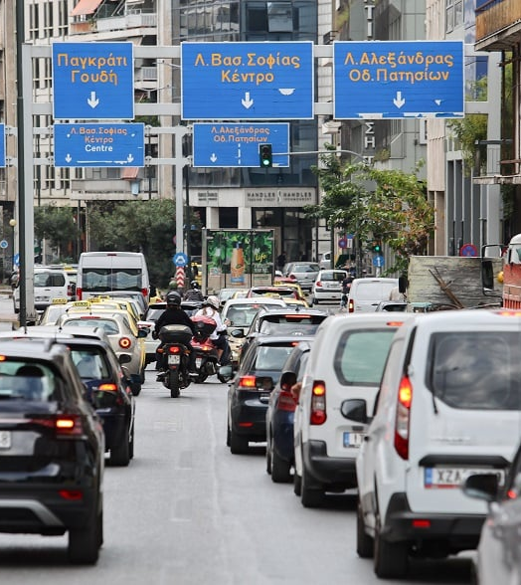
The Problems
Traffic:
Traffic violations
Accident rates
Driver behavior & awareness
Road safety
Peak-hour congestion
Parking:
Cut cruising
Double parking
Notes:
To understand what needs improvement, we first looked at the major issues in current mobility systems. Starting with traffic: a high number of traffic violations and accidents, often linked to poor driver behavior and low awareness. Road safety remains a big concern, especially during peak-hour congestion, when the city’s infrastructure is pushed to its limits. These problems lead to lost time, pollution, and frustration. When it comes to parking, the situation is similar. A lot of time is lost simply by cruising for available spots, which increases overall traffic density. Double parking is another major issue, it blocks lanes, creates safety hazards, and disrupts the flow of vehicles. Together, these challenges show that traffic and parking can’t be treated separately. They are part of the same urban ecosystem.

Slide 3
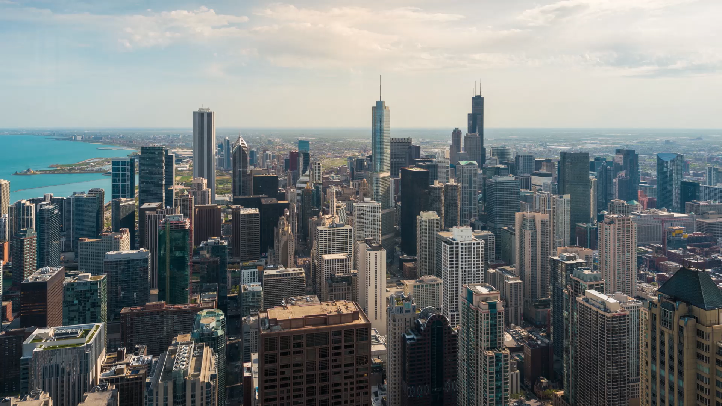
The Solution
The City: AI Analytics Hub
Live Dashboards: Real-time map views and Grafana dashboards for traffic monitoring
AI Suggestions: Insights to improve traffic flow and parking efficiency
The Driver: Smart Mobile App
Smart Navigation: Direct routing to the nearest available parking and live traffic updates
Active Engagement: A reward system for safe driving and an accident reporting feature

Slide 4
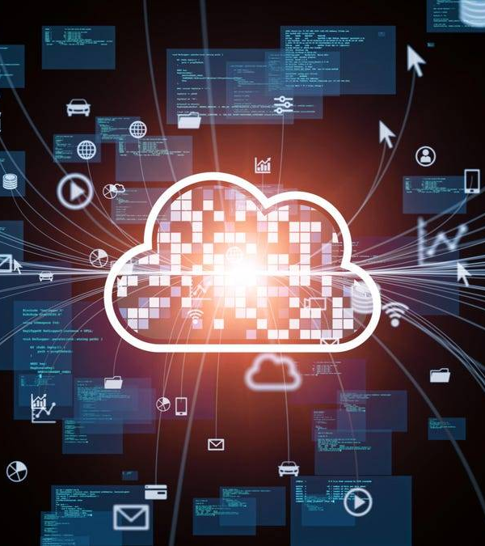
Architecture

Slide 5
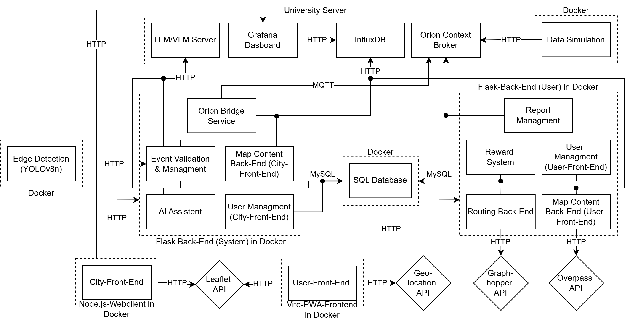

Slide 6
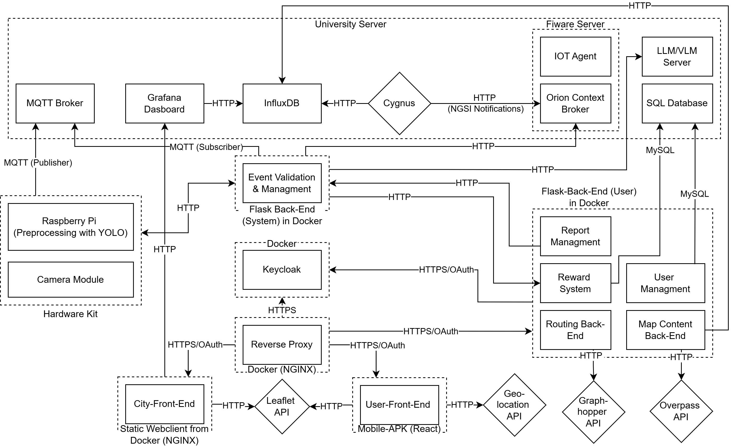

Slide 7

The Features: City Administration & Planning Office
Adaptive Analytics Dashboard: Combines heatmap and graph views for real-time traffic, parking, and safety insights
Advanced Filtering: Analyze specific timeframes or focus areas for deeper planning insights
Improvement Suggestions: AI-based recommendations for signage, road markings, and infrastructure design
Notes:
Turns mobility data into real-time insights for planners.
Dashboard: Heatmap & graphs for traffic, parking, safety.
Filtering: Focus on timeframes or hotspots.
Simulation: Test effects of new roads or policies.
AI Suggestions: Smart fixes for infrastructure.
Emergency Alerts: Instant notifications to authorities.
Builds a data-driven foundation for smarter city planning.
Transition: Now let’s see how drivers interact with this system on their side.

Slide 8

The Features: End-User (Drivers)
Smart Parking & Rerouting: Real-time route and parking suggestions
Dynamic Map View: Live traffic & parking updates
Community Reporting: Report accidents
Reward System: Earn rewards for safe & lawful driving
Notes:
Safety alerts via popups and voiceinputs / audio over speakers
Reward System: city chooses to participate in rewarding : discounts or coupons
EV Charging: only select parking spaces with EV station

Slide 9
Our Technologies
IoT & Infra:
FIWARE (Orion)
Docker
Python (FastAPI)
Artifical Inteligence:
YOLOv8 nano
VLM (qwen2.5vl:3b-q4_K_M)
LLM (mistral:7b-instruct-q4_K_M)
Web & Mobile:
React (Vite)
Leaflet
Grafana
Databases:
MySQL
InfluxDB

Slide 10
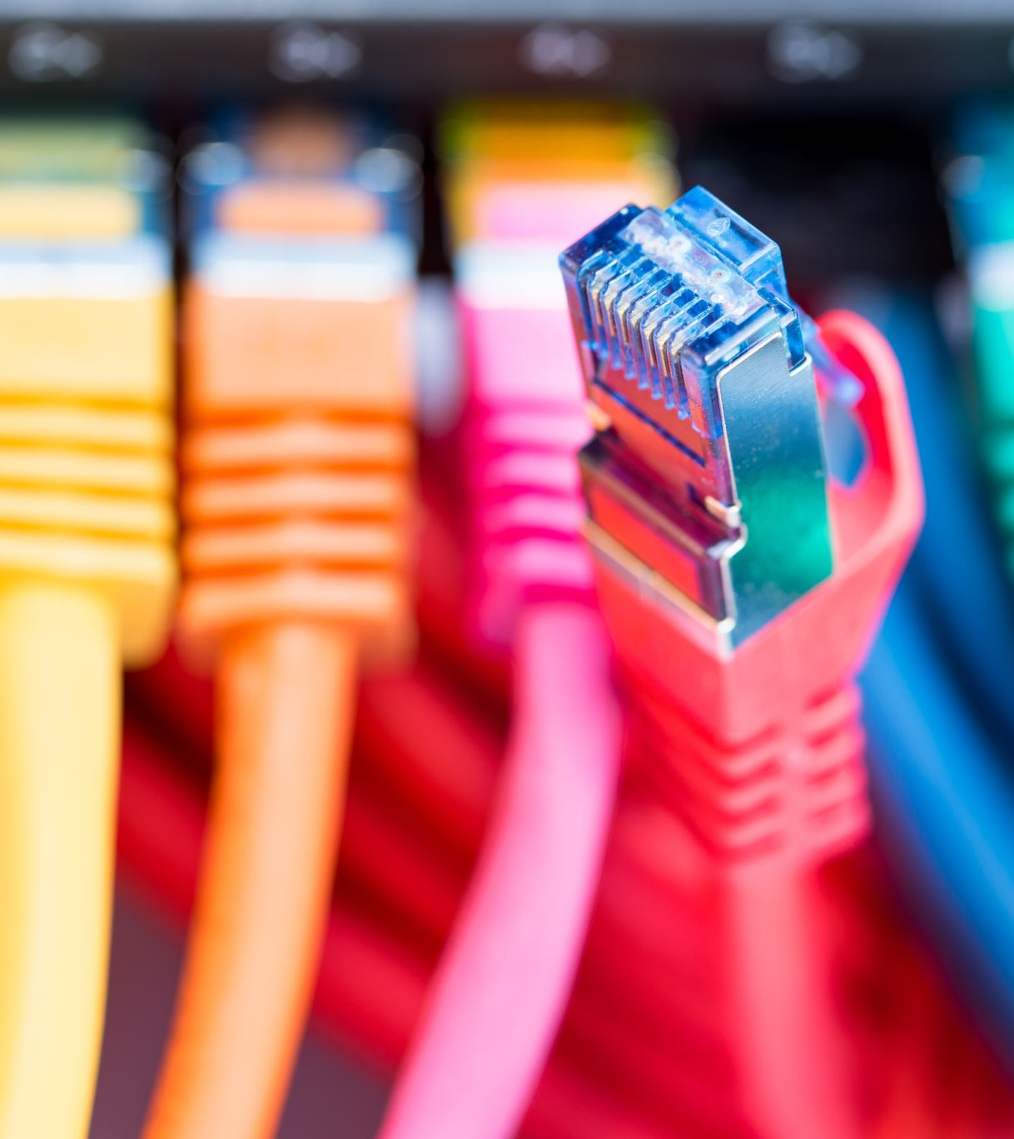
Solution Demo

Slide 11
Timeline
1. Phase (05.11.25-11.12.25)
Fiware Communication Module
Orion Bridge Service
React Setup
YOLO Environment Setup
2. Phase (12.12.25.-22.12.25)
Data Faker Imp.
Leaflet & Graphh. Int.
YOLO Tests
Grafana Dashb. With Filters
AI Suggestions
3. Phase (27.12.25-12.01.26)
Geo API Int.
Reward Sys.
Cygnus Int.
User Management (City-Dashb.)
4. Phase (13.01.26-21.01.26)
Report Sys.
User Managmnets (PWA)
YOLO Preprossesing
5. Phase (22.01.26-28.01.26)
Event Management
Testing & Debugging
Final Version of Solution & Presentation

Slide 12
Task Distribution
Marvin | Viktor | Petra | Leander
Web App Routing Backend Map Vis. (PWA) User Managment (PWA) | YOLO Preprocessing Event Managment | Cygnus Integration Report System | City Dashb. Grafana Dashb. Map Vis. (City) AI Sugg. User Managmnet (City) Orion & Influx Data Faker

Slide 13
Difficulties
Data Persistence (Cygnus vs. Custom)
Issue: The standard Cygnus connector proved too rigid and unstable for our setup
Pivot: We engineered a custom Python Bridge Service to sync Orion data to InfluxDB manually
Edge AI Performance
Issue: YOLOv8 nano inference creates a massive CPU bottleneck (especially on a Raspberry PI)
Takeaway: Use PC for now. The Pi could work later if we use INT8 optimization or a cheap AI accelerator (lHailo-8L)
Stack Complexity
Issue: Integrating distinct worlds (IoT Hardware, Web, Database, Mobile)
Solution: Strict Microservices Architecture was the only way to manage the breadth of technologies

